Slide 1
Agenda
PRU architecture Overview
Code Development
Communicating with LINUX (ARM)

Slide 2

ARM SoC Architecture
ARM Subsystem
Cortex-A8
L3 Interconnect
L1D, L1P caches (32KB):
Single cycle access
L2 cache (256KB)
Min latency of 8 cycles
Access to on-chip SRAM:
20 cycles
Access to L3 RAM over L3 Interconnect:
40 cycles
L1 Instruction Cache
L1 Data Cache
L2 Data Cache
L4 Interconnect
Shared
Memory
Peripherals
Peripherals
GP I/O
Notes:
- ARM Cortex-A8 designed for performance
- High Performance != Real Time

Slide 3
PRU in Sitara Device
L3 Interconnect
ARM Subsystem
Programmable Real-Time Unit (PRU) Subsystem
Interconnect
PRU0 (200MHz)
PRU1 (200MHz)
PRU0 I/O
Cortex-A8
L3 Interconnect
PRU1 I/O
Shared RAM
Inst. RAM
DataRAM
Inst. RAM
DataRAM
L1 Instruction Cache
L1 Data Cache
L2 Data Cache
L4 Interconnect
INTC
Peripherals
Shared
Memory
Peripherals
Peripherals
GP I/O
Notes:
ARM + PRU + memories + peripherals = SoC
PRU works as a co-processor in system-level implementation, or
- PRU works independently

Slide 4
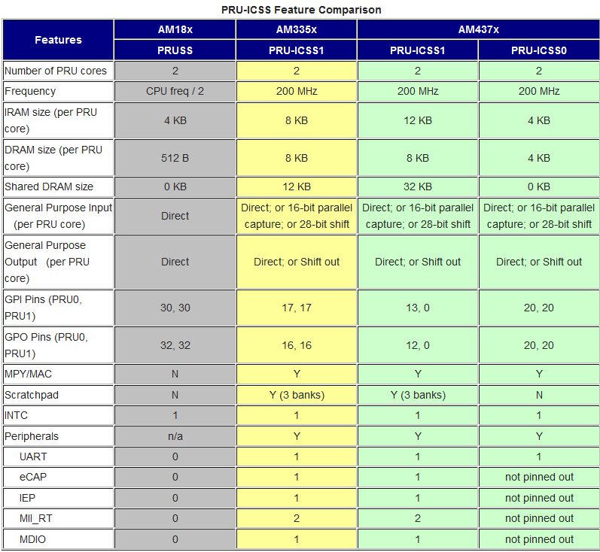

Slide 5
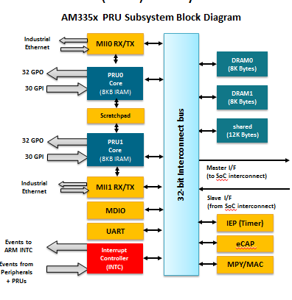
Programmable Real-Time Unit (PRU) Subsystem
Reference Guide
http://mythopoeic.org/BBB-PRU/am335xPruReferenceGuide.pdf
Notes:
Notes:
AM335x:
- 8K Byte instruction RAM (2K instructions) per core
- 8K Bytes data RAM per core
- 12K Bytes shared RAM
Although PRU can only run from IRAM, it can be reset and new code can be loaded. This allows you to use the PRU for multiple functions.
Each PRU has a total of 32 output pins and 30 input pins. Pins are multiplexed with other peripherals at the system level so there are pin muxing considerations to be kept in mind.
Main point:
The PRU subsystem has key features and dedicated resources that help solve real-time problems.
Key features:
2 PRU cores – each with dedicated instruction RAM
- RISC processors
IEP (timer) –
eCap
instruction fetch: grab the instruction located at address pc instruction
decode: parse the instruction. what is the opcode, what registers do we need, what is value of the immediate, etc read registers:
grab whatever register values we need from the register file execute: we now have all the data we need to execute the instruction,
so execute the instruction. if it's an add instruction, add the register values, etc.
write register: write a new register value into the register file, if necessary [not necessary for stores]

Slide 6
Programmable Real-Time Unit (PRU) Subsystem
Programmable Real-Time Unit (PRU) is a low-latency microcontroller subsystem
Two independent PRU execution units
32-Bit RISC architecture
200MHz – 5ns per instruction
Single cycle execution - No pipeline
Dedicated instruction and data RAM per core
Shared RAM
Interrupt Controller for system event handling
Fast I/O interface
Up to 30 inputs and 32 outputs on external pins per PRU unit
AM335x PRU Subsystem Block Diagram
Industrial Ethernet
MII0 RX/TX
DRAM0
(8K Bytes)
32 GPO
PRU0 Core
(8KB IRAM)
30 GPI
DRAM1
(8K Bytes)
Scratchpad
shared
(12K Bytes)
32 GPO
PRU1 Core
(8KB IRAM)
32-bit Interconnect bus
30 GPI
Master I/F (to SoC interconnect)
Industrial Ethernet
MII1 RX/TX
Slave I/F (from SoC interconnect)
MDIO
IEP (Timer)
UART
Events to ARM INTC
eCAP
Interrupt Controller (INTC)
Events from Peripherals + PRUs
MPY/MAC
Notes:
Notes:
AM335x:
- 8K Byte instruction RAM (2K instructions) per core
- 8K Bytes data RAM per core
- 12K Bytes shared RAM
Although PRU can only run from IRAM, it can be reset and new code can be loaded. This allows you to use the PRU for multiple functions.
Each PRU has a total of 32 output pins and 30 input pins. Pins are multiplexed with other peripherals at the system level so there are pin muxing considerations to be kept in mind.
Main point:
The PRU subsystem has key features and dedicated resources that help solve real-time problems.
Key features:
2 PRU cores – each with dedicated instruction RAM
- RISC processors
IEP (timer) –
eCap – PWM (Pulse width Modulation) Enhanced Capture Module – input or output
instruction fetch: grab the instruction located at address pc instruction
decode: parse the instruction. what is the opcode, what registers do we need, what is value of the immediate, etc read registers:
grab whatever register values we need from the register file execute: we now have all the data we need to execute the instruction,
so execute the instruction. if it's an add instruction, add the register values, etc.
write register: write a new register value into the register file, if necessary [not necessary for stores]

Slide 7
PRU features
OCP – open core protocol – master port and slave port
2 PRUs, each had private memory
8K data
8K program
In between there Is scratch pad memory (3 banks, 30 32-bit registers)
Shared memory:
Shared ram 12k
AM335x PRU Subsystem Block Diagram
Industrial Ethernet
MII0 RX/TX
DRAM0
(8K Bytes)
PRU0 Core
(8KB IRAM)
DRAM1
(8K Bytes)
Scratchpad
shared
(12K Bytes)
PRU1 Core
(8KB IRAM)
32-bit Interconnect bus
Master I/F (to SoC interconnect)
Industrial Ethernet
MII1 RX/TX
MDIO
Slave I/F (from SoC interconnect)
UART
IEP (Timer)
Events to ARM INTC
Interrupt Controller (INTC)
eCAP
Events from Peripherals + PRUs
MPY/MAC

Slide 8
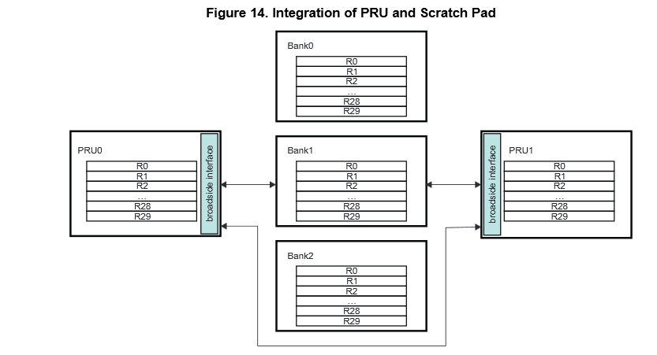
Scratch Pad

Slide 9
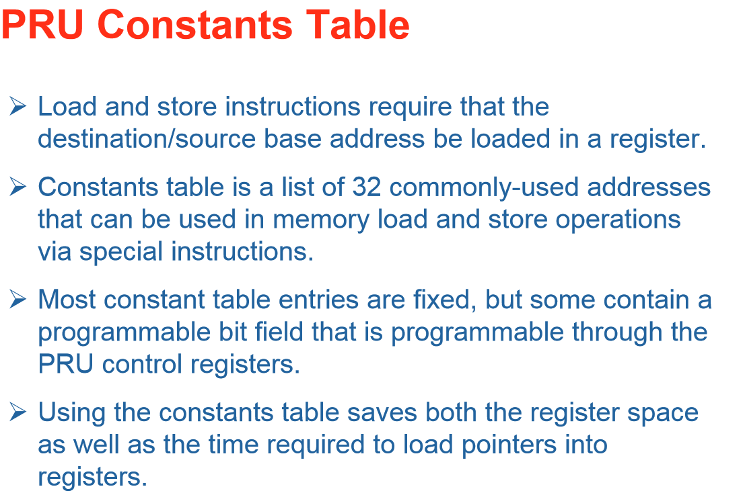

Slide 10
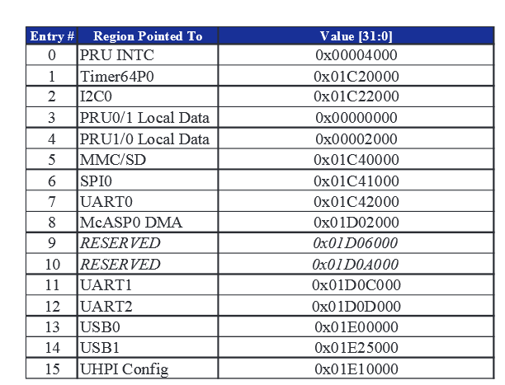
Constant Table

Slide 11
PRU features
Interrupt Controller
64 input events
10 interrupt channels – hardware priorities
16 software events can be generated by 2 PRU
Two MII ports
One MDIO port
IEP (Industrial Ethernet peripheral)
Enhanced Capture Module (ECAP)
Notes:
IEP – Industrial Ethernet Peripheral - refers to the use of standard Ethernet protocols with rugged connectors and extended temperature switches in an industrial environment
The industrial ethernet peripheral (IEP) is intended to do the hardware work required for industrial ethernet
functions. The IEP module features an industrial ethernet timer with eight compare events

Slide 12
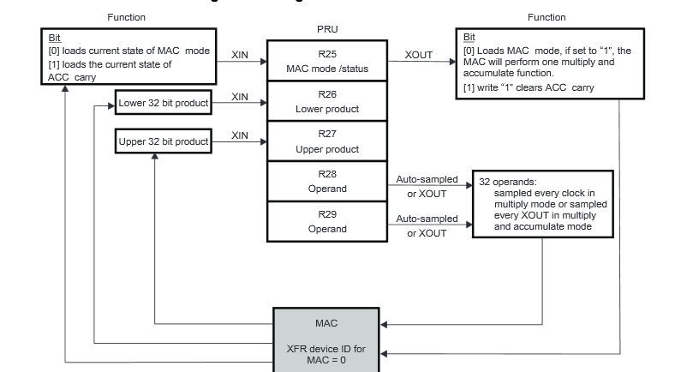
MAC/MPY integration

Slide 13
Features & Benefits
Feature | Benefit
Each PRU has dedicated instruction and data memory and can operate independently or in coordination with the ARM or the other PRU core | Use each PRU for a different task; use PRUs in tandem for more advanced tasks
Access all SoC resources (peripherals, memory, etc.) | Direct access to buffer data; leverage system peripherals for various implementations
Interrupt controller for monitoring and generating system events | Communication with higher level software running on ARM; detection of peripheral events
Dedicated, fast input and output pins | Input/output interface implementation; detect and react to I/O event within two PRU cycles
Small, deterministic instruction set with multiple bit-manipulation instructions | Easy to use; fast learning curve

Slide 14
PRU Functional Block Diagram
General Purpose Registers
All instructions are performed on registers and complete in a single cycle
Register file appears as linear block for all register to memory operations
Constant Table
Ease SW development by providing freq used constants
Peripheral base addresses
Few entries programmable
PRU Execution unit
CONST TABLE
R0
R1
R2
EXECUTION UNIT
Execution Unit
Logical, arithmetic, and flow control instructions
Scalar, no Pipeline, Little Endian
Register-to-register data flow
Addressing modes: Ld Immediate & Ld/St to Mem
…
R29
32 GPO
R30
30 GPI
R31
Instruction RAM
INTC
Special Registers (R30 and R31)
R30
Write: 32 GPO
R31
Read: 30 GPI + 2 Host Int status
Write: Generate INTC Event
Instruction RAM
8KB in size; 2K Instructions
Can be updated with PRU reset
Notes:
14
14
This slide gives a functional block diagram of the PRU core. The two PRU cores in the PRU SS each possess these features.
Execution Unit
The PRU core supports logic, arithmetic, and flow control instructions. About 40 instructions in total.
The PRU core does not use a pipeline and only one data item can be processed at a time (scalar), this makes the PRU simple to program. The PRU is a little endian processor.
Each PRU has a register-to-register data flow architecture, meaning all operations (except load immediate) accept only registers as operands. For example, to add a constant to a register, you must first load the constant into a register and add the two registers.
There are two ways to move data around:
First, you can load a 16-bit immediate into a register. Therefore, to init a 32-bit register, you need to do two 16-bit loads.
Second, to load or store data from memory, you need to load the address to a register and use a load burst or store burst instruction to move data between registers and memory. Notice data is moved between memory and registers.
Instruction RAM
The PRU core includes a 4KByte instruction RAM allowing for up to 1K instructions.
The instruction RAM is fully accessible by the ARM or the DSP when the PRU is in reset.
General Purpose Registers
All PRU instructions are performed on the 32 general purpose registers of each PRU core.
These registers behave as a linear block when used with memory load/store instructions. This allows you to burst multiple data bytes directly to (or from) memory to multiple registers. For example, you can burst 8 bytes of data from memory to the register set starting at R0. This would load 4 bytes into R0 and 4 bytes into R1. Also, you don’t have to align data on a register boundary, you can specify the data copy start at word 1 of R0 or byte 3 of R2.
One useful feature of the PRU is that it is easy to select bits, bytes, and words within a register through a “dot” operator. This allows for easy manipulation of data. The “dot” operator will be discussed later.
Special Registers (R30 and R31)
Each PRU core has 30 GPIs and 32 GPOs. Additionally, each PRU can generate up to 32 events to the INTC and it can read the status of two host interrupts from the INTC. As we’ll see later, the host interrupts are the combined outputs of INTC.
Writing to R30 toggles the GPOs of the PRU.
Writing to R31 generate events to the interrupt controller.
Reading from R31 returns the status of the GPIs and the two host interrupts generated by the INTC.
Constants Table
The PRU will often have to access system resources like memory mapped registers or DSP L2 memory. The constants table contains some of the most commonly-used addresses. The constants table can be used to save instructions and cycles. Some of the entries in the constants table are programmable.
Notes:
Execution Unit Highlights
Supports logical, arithmetic, and flow control instructions
Scalar: One data item at a time processing
No pipelining
Little endian, just like the ARM and DSP.
It has a register-to-register data flow architecture, meaning all operations (except load immediate) accept only registers as operands. For example, to add a constant to a register, you must first load the constant into a register and add the two registers.
Two ways to move data around:
First, you can load a 16-bit immediate into a register. Therefore, to init a 32-bit register, you need to do two 16-bit loads.
Second, to load or store data from memory, you need to load the address to a register and use a load burst or store burst instruction to move data between registers and memory. Notice data is moved between memory and registers, this brings us to the register set…
Register Set
30 32-bit general purpose registers and two special purpose registers, which will be discussed next.
Registers behave as a linear block for all memory operations. This allows you to burst multiple data bytes directly to (or from) memory to multiple registers. For example, you can burst 8 bytes of data from memory to the register set starting at R0. This would load 4 bytes into R0 and 4 bytes into R1. Also, you don’t have to align data on a register boundary, you can specify the data copy start at word 1 of R0 or byte 3 of R2.
One useful feature of the PRU is that it is easy to select bits, bytes, and words within a register through a “dot” operator. This allows for easy manipulation of data. The “dot” operator will be discussed later.
Special Regs 30 and 31
Each PRU core has 30 GPIs and 32 GPOs. Additionally, each PRU can generate up to 32 events to the INTC and it can read the status of two host interrupts from the INTC. As we’ll see later, the host interrupts are the combined outputs of INTC.
Writing to R30 toggles the GPOs of the PRU.
Writing to R31 generate events to the interrupt controller.
Reading from R31 returns the status of the GPIs and the two host interrupts generated by the INTC.
Constants Table
The PRU will often have to access system resources like memory mapped registers or DSP L2 memory. The constants table contains some of the most commonly-used addresses. As we’ll see next, the constants table can be used to save instructions and cycles. Some of the entries in the constants table are programmable.

Slide 15
Fast I/O Interface
Cortex A8
Reduced latency through direct access to pins
Read or toggle I/O within a single PRU cycle
Detect and react to I/O event within two PRU cycles
Independent general purpose inputs (GPIs) and general purpose outputs (GPOs)
PRU R31 directly reads from up to 30 GPI pins
PRU R30 directly writes up to 32 PRU GPOs
Configurable I/O modes per PRU core
GP input modes
Direct connect
16-bit parallel capture
28-bit shift
GP output modes
Direct connect
Shift out
L3F L3S
L4 PER
Peripherals
GPIO1
GPIO2
GPIO3
....
PRU Subsystem
GPIO 3.19
PRU output 5
Pinmux
Device pin
Notes:
GPIOs:
Direct access
Low latency
Measure latency difference – may want to compare against the ARM accessing a GPIO…
The PRU enhanced GPIO are much faster as the PRU does access the pin directly. We physically use the same physical pins but used a different pinmux option. The below picture show the differences between the two setup:
While generic general-purpose input/output (GPIO) pins can be used to implement some functions, GPIO supported by the SoC can be inadequate when a fast response time is required since often these pins cannot be toggled or sampled at a very fast rate. The PRU includes dedicated, fast input/output pins which can be read or toggled within a single cycle.

Slide 16
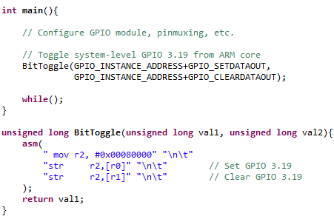

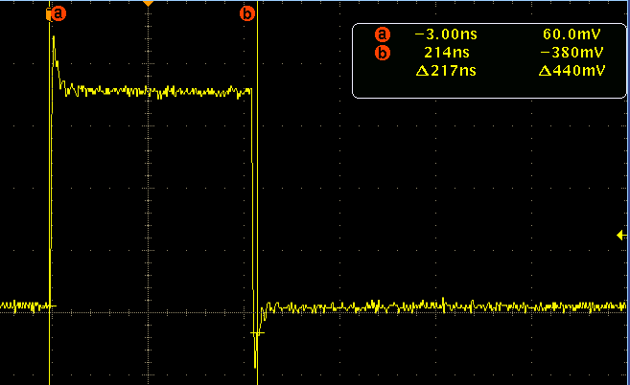
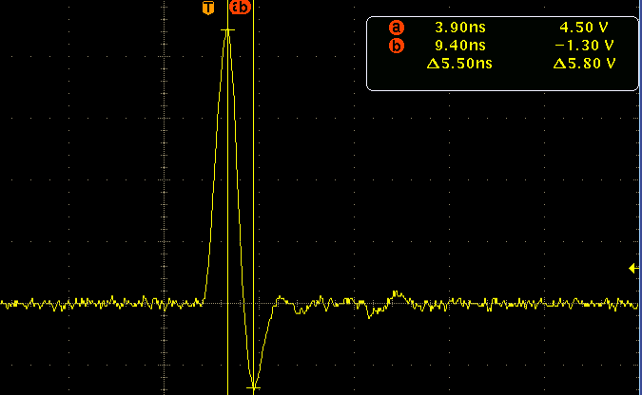
GPIO Toggle: Bench measurements
ARM GPIO Toggle
PRU IO Toggle:
~200ns
~5ns = ~40x Faster

Slide 17
Integrated Peripherals
Provide reduced PRU read/write access latency compared to external peripherals
Local peripherals don’t need to go through external L3 or L4 interconnects
Can be used by PRU or by the ARM as additional hardware peripherals on the device
Integrated peripherals:
PRU UART
PRU eCAP
PRU MDIO
PRU MII_RT
PRU IEP
Interconnect
Programmable Real-Time Unit (PRU) Subsystem
PRU0 (200MHz)
PRU1 (200MHz)
Real-time Ethernet specific modules
Shared RAM
Inst. RAM
DataRAM
Inst. RAM
DataRAM
INTC
UART
eCAP
MII x2
MDIO
IEP (Timer)

Slide 18
PRU “Interrupts”
The PRU does not support asynchronous interrupts.
However, specialized h/w and instructions facilitate efficient polling of system events.
The PRU-ICSS can also generate interrupts for the ARM, other PRU-ICSS, and sync events for EDMA.
From UofT CSC469 lecture notes, “Polling is like picking up your phone every few seconds to see if you have a call. Interrupts are like waiting for the phone to ring.
Interrupts win if processor has other work to do and event response time is not critical
Polling can be better if processor has to respond to an event ASAP”
Asynchronous interrupts can introduce jitter in execution time and generally reduce determinism. The PRU is optimized for highly deterministic operation.

Slide 19
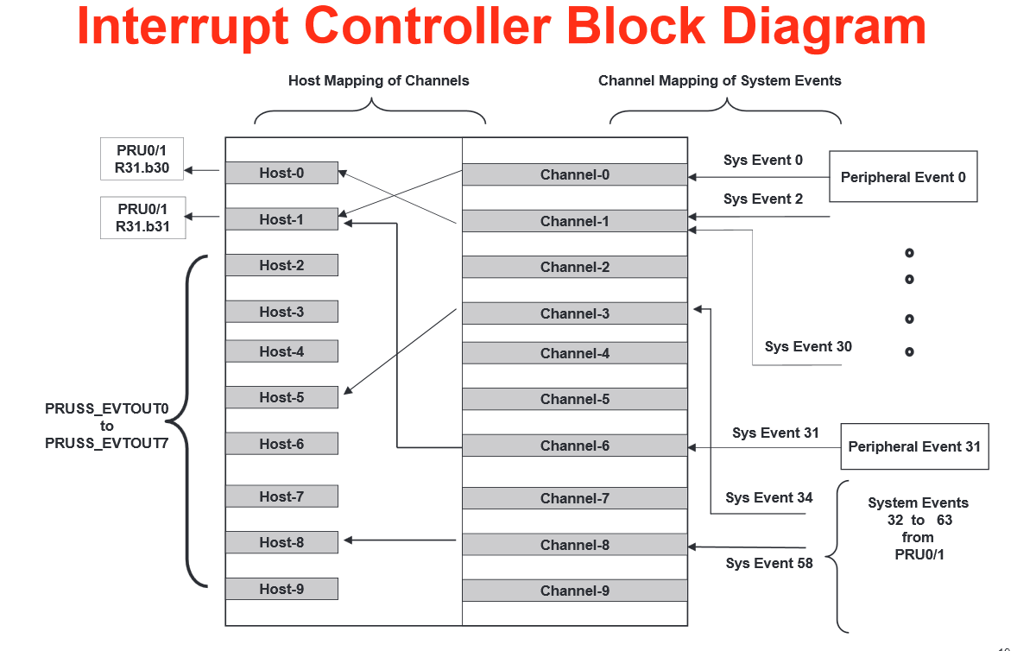

Slide 20
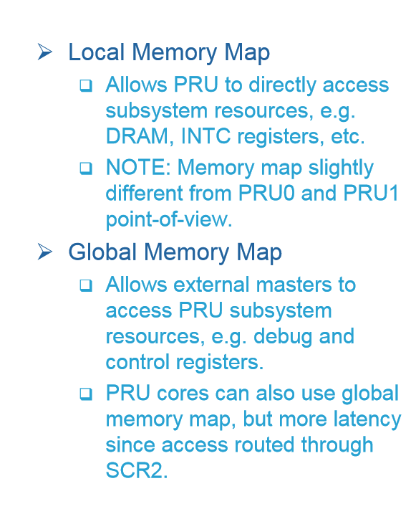

Slide 21
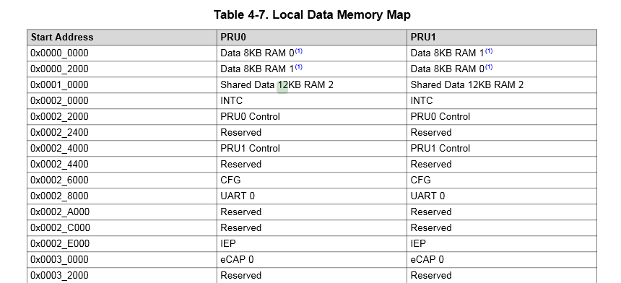
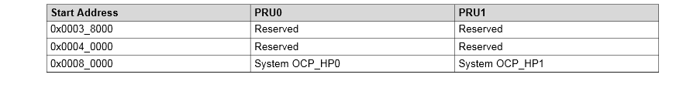
PRU Memory Map (local)
Each PRU sees his RAN at 0x000 0000 and the other one at 0x0000 2000

Slide 22
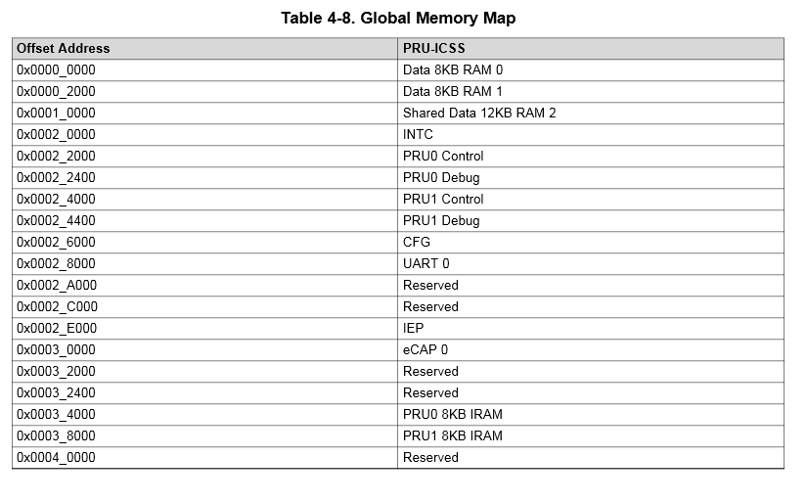
PRU Memory Map (Global)
This is the host view of the PRU memories

Slide 23
PRU Read Latencies: Local vs Global Memory Map
 | Local MMR Access ( PRU cycles @ 200MHz ) | Global MMR Access ( PRU cycles @ 200MHz )
PRU R31 (GPI) | 1 | N/A
PRU CTRL | 4 | 36
PRU CFG | 3 | 35
PRU INTC | 3 | 35
PRU DRAM | 3 | 35
PRU Shared DRAM | 3 | 35
PRU ECAP | 4 | 36
PRU UART | 14 | 46
PRU IEP | 12 | 44
Note: Latency values listed are “best-case” values.

Slide 24
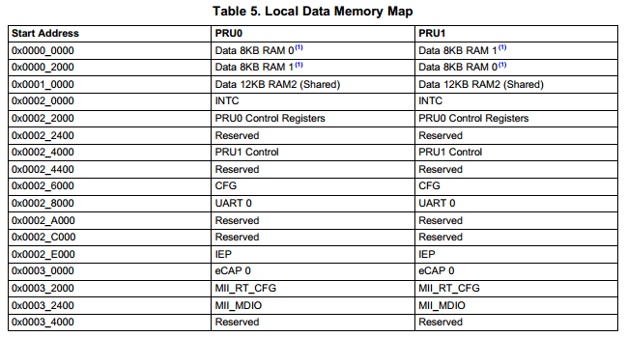
PRU Memory Access FAQ
Q: Why does my PRU firmware hang when reading or writing to an address external to the PRU Subsystem?
A: The OCP master port is in standby and needs to be enabled in the PRU-ICSS CFG register space, SYSCFG[STANDBY_INIT].
Notes:
/* Clear SYSCFG[STANDBY_INIT] to enable OCP master port */
CT_CFG.SYSCFG_bit.STANDBY_INIT = 0;

Slide 25
AM335x PRU-ICSS Power
PRU Test Case: Addition and Subtraction loop
Baseline: PRU released from reset and PRU clock is enabled
Test Case | OPP100 (mW) PRU 200MHz@1.1V
Baseline | 13.1
PRU test on PRU0 | 17.3
PRU test on PRU1 | 16.8
PRU test on PRU0 and PRU1 | 20.4

Slide 26
AM437x PRU-ICSS Power
PRU Test Case: Addition and Subtraction loop
Baseline: PRU released from reset and PRU clock is enabled
Test Case | OPP100 (mW) PRU 200MHz@1.1V | OPP50 (mW) PRU 100MHz@0.95V
Baseline | 28.4 | 12.6
PRU test on ICSS0_PRU0 | 37.3 | 15.8
PRU test on ICSS0_PRU1 | 36.1 | 15.3
PRU test on ICSS1_PRU0 | 40.0 | 16.5
PRU test on ICSS1_PRU1 | 36.6 | 15.0
PRU test on all 4 PRUs | 55.2 | 21.4

Slide 27
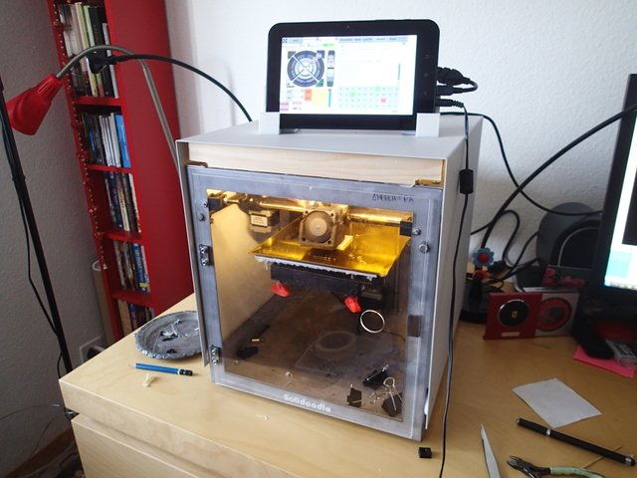
Use Cases Examples
Industrial Protocols
ASRC
10/100 Switch
Smart Card
DSP-like functions
Filtering
FSK Modulation
LCD I/F
Camera I/F
RS-485
UART
SPI
Monitor Sensors
I2C
Bit banging
Custom/Complex PWM
Stepper motor control
Not all use cases are feasible on PRU
Development complexity
Technical constraints (i.e. running Linux on PRU)
Development Complexity

Slide 28
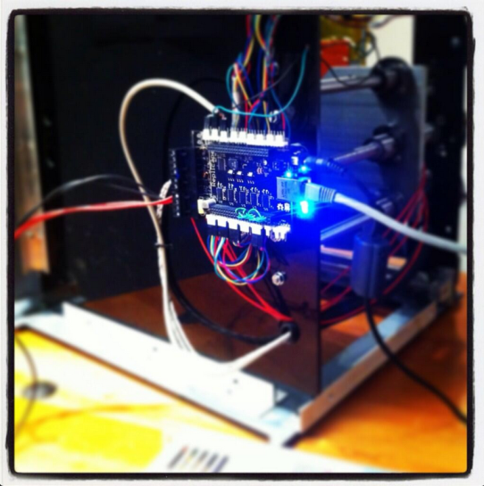
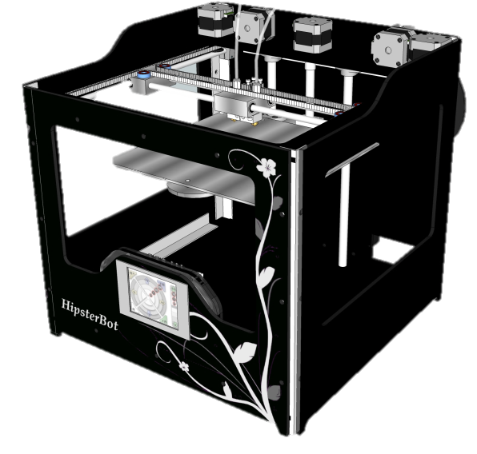
Replicape 3D Printer
Replicate 3D Printer uses AM335x on BeagleBone
Cortex-A8 runs Linux, networking, HMI, model processing
Host apps written in Python
PRU controls step and direction of 5 stepper motors
App written in PRU assembly
A8 calculates data, PRU communicates with motors
Shared region of DDR reserved for A8/PRU communication
Data consist of pin/delay timing tuples (8 bytes each)
Sequence:
GPIO pins are set – one or more of the 32-bit GPIO banks set with a predefined mask
Delay is applied (# of 200MHz instructions)
After sequence completes, PRU sends a signal to the host indicating that the segment is finished
Host updates its memory usage for the PRU
More info @ hipstercircuits.com
Notes:
On Replicape one PRU is used for controlling the step and direction pins for all the five stepper motor controllers on the board. The way it has been done is by having a region is set aside in the DDR memory that is shared between the host CPU and the PRU for feeding the stepper timing data. The timing data consist of (pin, delay) tuples, each 8 bytes long, so first the pins are set, and this is really just an update of one or more of the 32bit GPIO banks with a predefined mask, then the delay is applied in number of 200 MHz instructions to wait. Each sequence of several pin, delay tuple is terminated by a zero to indicate end of sequence. This puts a limit on the pin configurations, so there is no overlap between the banks and never pins=0 at the start.
Once the sequence is completed, the PRU sends a signal to the host indicating that the segment is finished and the host must then update its memory usage for the PRU so it never overwrites the beginning of the circular buffer. Once the end of the buffer is reached, a magic number is used to indicate a jump back to the beginning of the buffer. The host software is written in Python and the PRU code is assembly.

Slide 29
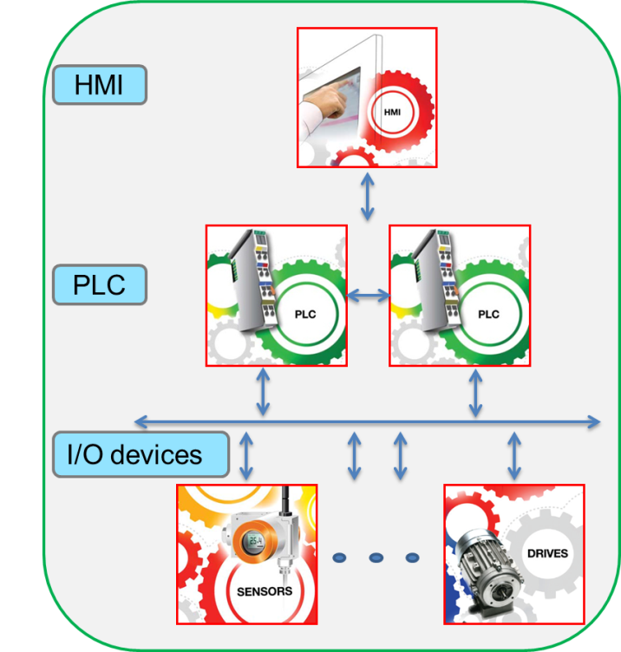
TI Processors provide efficient & Scalable architectures for the entire Industrial Automation system
Sitara Value Proposition
Focus on Innovation
Differentiated ARM+PRU architecture enabling integrated multi-protocol industrial communications
Industry-leading integration enabling smaller systems
Industry-leading low power consumption enabling fanless designs
Scalability in CPU performance
MCU to MPU
Single to multi-core architecture
Support for HLOS, RTOS and No-OS (Starterware)
Scalability for the entire automation System
ARM only, ARM+PRU, ARM+PRU+GFX options (Pin-pin compatible for some products)
Best-in-class Quality, Reliability and Availability
- Extended Temperature, 100K+ Power on Hours
- Guaranteed 10+ years product life
Notes:
29

Slide 30
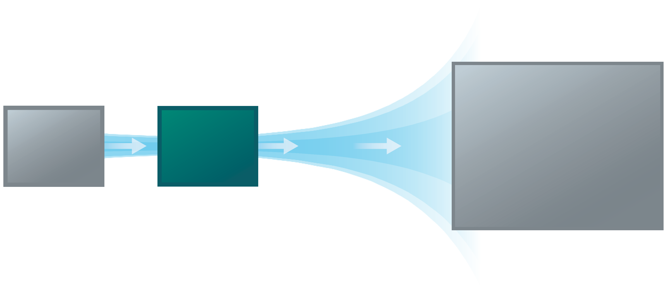

TI solves the complex communications problem by integrating multi-protocol support in the ARM SoCs
AM1810 (Profibus)
AM335x (Multi-protocols)
AM435x (Multi-protocols)
AM57xx (Roadmap for Multi-protocol, host/slave)
MCU or MPU
(Protocol Stack)
Host Interface
Ind Comm
ASIC/FPGA
(MAC layer)
ARM
CPU
(Stack and application)
PRU-ICSS
UART/MII
Timer
PRU0/1
Shared Memory
Typical Solution – Today
MCU/MPU for application
External ASIC/FPGA for communications (especially for slave)
PRU-ICSS (PRU based Industrial Communications Subsystem)
TI’s ARM + PRU solution = 4 benefits
System BOM savings (>40%) by eliminating the external ASIC
Supports multiple protocols using the same hardware (PRU is completely programmable)
Easily adapt to changing standards or create own (requires PRU expertise or 3P help)
Scalable solution for HMI, PLC and I/O devices

Slide 31
Code development C and Assembly

Slide 32
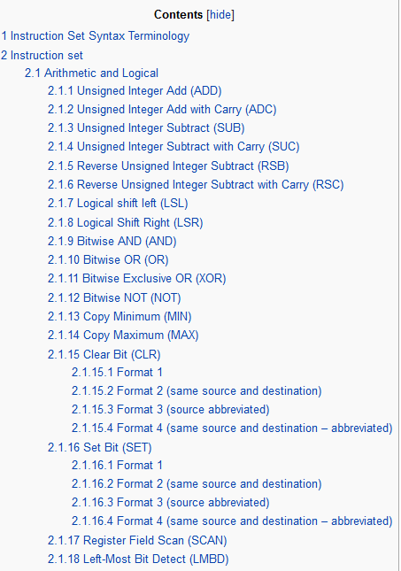
PRU Instruction Set
Screen shot of
http://processors.wiki.ti.com/index.php/PRU_Assembly_Instructions

Slide 33
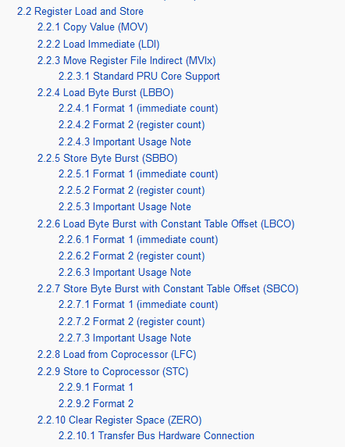
PRU Instruction Set
Screen shot of
http://processors.wiki.ti.com/index.php/PRU_Assembly_Instructions

Slide 34
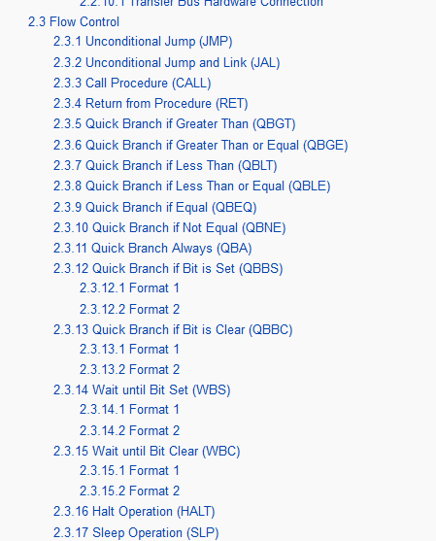
PRU Instruction Set
Screen shot of
http://processors.wiki.ti.com/index.php/PRU_Assembly_Instructions

Slide 35
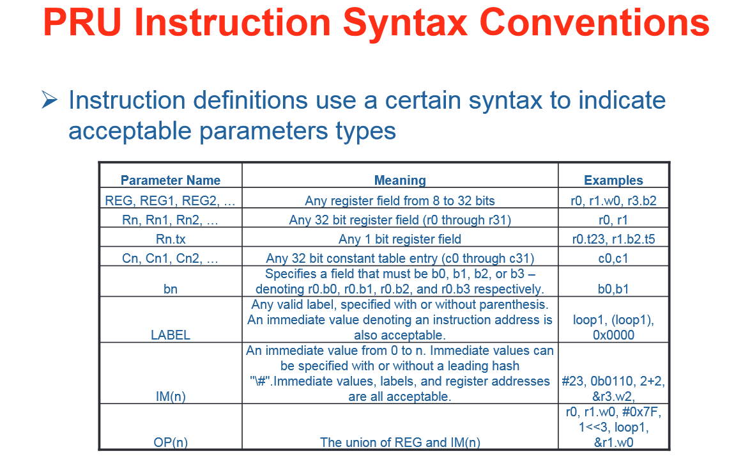

Slide 36
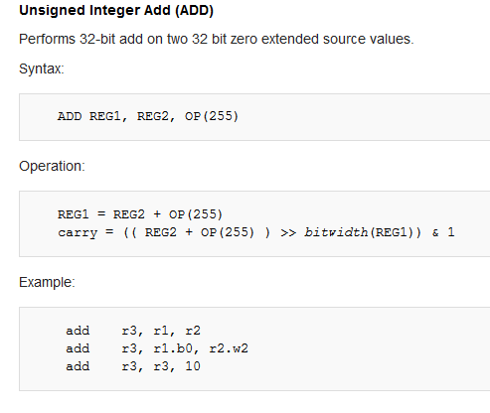
PRU Instruction Set
Add Example

Slide 37
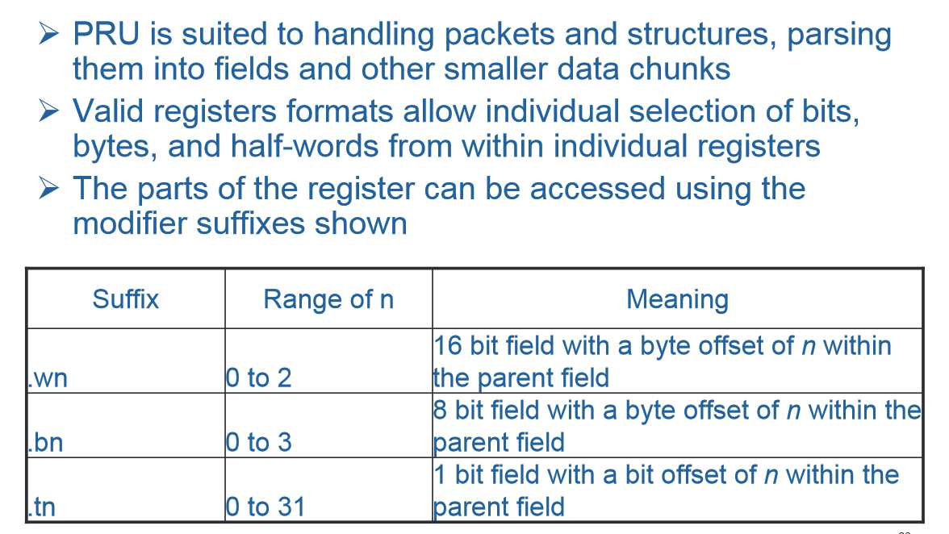

Slide 38
Building PRU executables
PSAM
Code generation Tools
Assembler
C compiler

Slide 39
What is PASM
PASM is a command line driven assembler
It is designed to build single executable images using a flexible source code syntax and a variety of output options.
PASM is available for Windows and Linux
PASM User Guide and Information
http://processors.wiki.ti.com/index.php/PASM_Tool

Slide 40
TI Code Generation Tools (CGT)
Standard tools for many TI’s processors
Can be used from CCS or command line
C compiler, assembler, linker
All development is done from IDE (CCS)

Slide 41
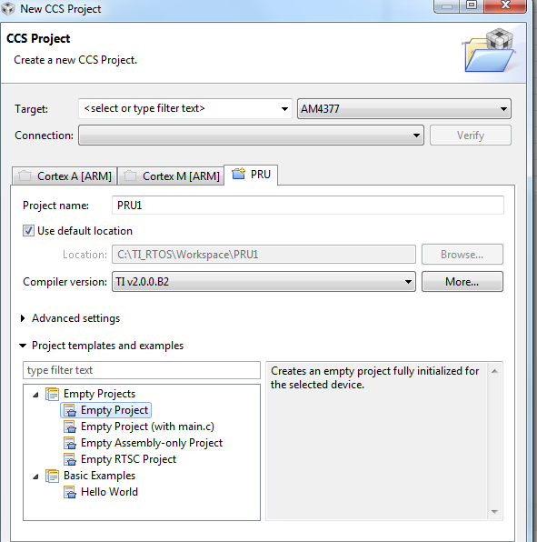
TI Code Generation Tools (CGT)

Slide 42
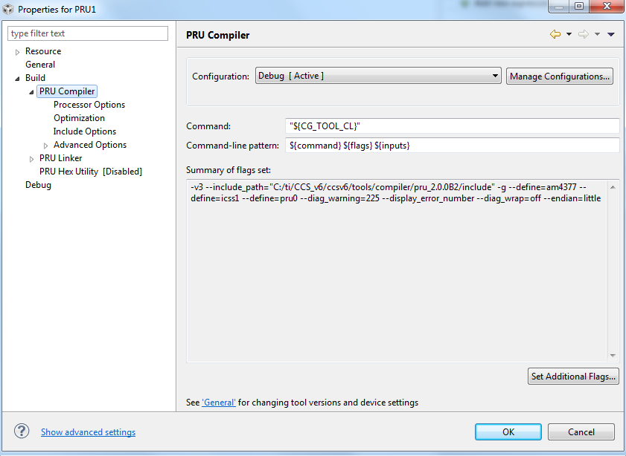
TI Code Generation Tools (CGT)

Slide 43
TI PRU CGT Assembler vs PASM
Advantages of using TI PRU Assembler over PASM
The biggest advantage is that the TI PRU linker produces ELF files that enable source-level debugging within CCS. No more debugging in disassembly window!!
The TI PRU assembler uses the same shell as other TI compilers. Customers only need to learn one set of conventions, directives, etc.
TI PRU assembler will be maintained in the future, while PASM will not be updated anymore.
The TI PRU assembler uses the powerful TI linker which allows more flexibility then PASM and facilitates linking PRU programs with host CPU image for runtime loading and symbol sharing.
Disadvantages of using TI PRU Assembler over PASM
Have to learn new directives if already used to PASM
TI PRU assembler requires more command line options and a linker command file.
Some porting effort required for reusing legacy PASM projects.
There are some differences in the instructions and directives supported TI PRU Assembler versus PASM. Theses are listed in the TI PRU Compiler package release notes which is located at the root of the install folder.

Slide 44
C Compiler
Developed and maintained by TI CGT team
Remains very similar to other TI compilers
Full support of C/C++
Adds PRU-specific functionality
Can take advantage of PRU architectural features automatically
Contains several intrinsic
List can be found in Compiler documentation
Full instruction-set Assembler for hand-tuned routines

Slide 45
TI PRU CGT Assembly vs C
Advantages of coding in Assembly over C
Code can be tweaked to save every last cycle and byte of RAM
No need to rely on the compiler to make code deterministic
Easily make use of scratchpad
Advantages of coding in C over Assembly
More code reusability
Can directly leverage kernel headers for interaction with kernel drivers
Optimizer is extremely intelligent at optimizing routines
“Accelerating” math via MAC unit, implementing LOOP instruction, etc.
Not mutually exclusive - inline Assembly can be easily added to a C project

Slide 46
Coding Considerations
There are some “tricks” we have to use to get the compiler to perform some operations
Variables have to be “mapped” to Constant Table entries
The compiler will automatically use the MAC unit if the --hardware_mac switch is passed to it
Optimization can be tricky; be sure to mark variables that can change via outside forces (e.g., host, other PRU core) as volatile

Slide 47
Coding Considerations
There are also some limitations
The C environment does not know that the final eight CT registers have a variable offset, and thus that feature cannot be easily utilized
The compiler does not currently use the scratchpad for register state saving
This support is tentatively planned for a future CGT release

Slide 48
PRU Register Headers
Created to make accessing a register easier
Register names match those in documentation
Code Completion feature in CCS automatically lists all members
Developed to allow a user to program at the register-level or at a bit-field level
Note that bit-field accesses could potentially cause some issues with other C compilers (e.g., gcc), but register-level shouldn’t
PRU cregister mechanism used to leverage constants table when possible.
Currently provides definition for the following:
PRU INTC
PRU Config
PRU IEP
PRU Control
PRU ECAP
PRU UART

Slide 49
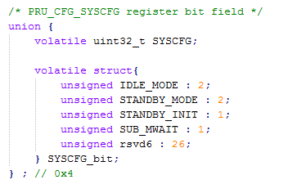

PRU Register Headers Layout
Excerpt from config.h
Access register directly pruCfg.SYSCFG
Or access specific bitfields CT_CFG.SYSCFG_bit.STANDBY_INIT
Example of how to use in C file
#include the specific header
Map the constant table entry to register structures
Access registers or fields

Slide 50
Communication with the Host

Slide 51
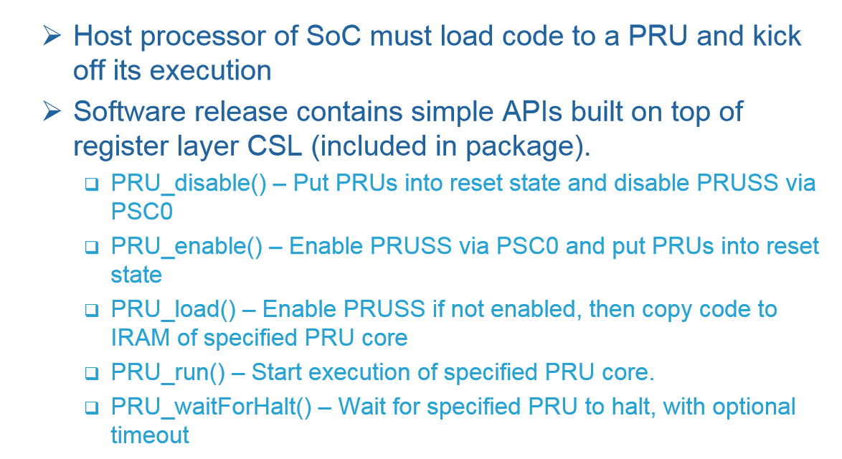

Slide 52
PRU SW Stack
Application
Application uses /dev/rpmsg-pru interface to send messages
User Space
Kernel
RemoteProc-PRU
rpmsg-PRU
Client drivers specifically for PRU core
RemoteProc
rpmsg
Core Linux drivers
DTB File passed from U-Boot
virtio
PRU FW
PRU Data Memory
PRU rpmsg lib
vring
PRU

Slide 53
Remoteproc
The remoteproc framework allows different platforms/architectures to control (power on, load firmware, power off) remote processors while abstracting any hardware differences
Documentation in the SDK release
/board-support/linux-3.12.10-ti2013.12.01/Documentation/remoteproc.txt
Remoteproc APIs
int rproc_boot(struct rproc *rproc)
void rproc_shutdown(struct rproc *rproc)
struct rproc *rproc_alloc()

Slide 54
rpmsg
rpmsg is a Linux framework designed to allow for message passing between the kernel and a remote processor
Documentation in the SDK release
/board-support/linux-3.12.10-ti2013.12.01/Documentation/rpmsg.txt
rpmsg APIs
int rpmsg_send(struct rpmsg_channel *rpdev, void *data, int len);
int register_rpmsg_driver(struct rpmsg_driver *rpdrv);

Slide 55
Virtio & Vring
Virtio is a virtualized I/O framework
We will use it to communicate with our virtio device (vdev)
There are several ‘standard’ vdevs, but we only use virtio_ring
The host and PRU will communicate with one another via the virtio_rings (vrings)
Virtual device definition example in the SDK release
/board-support/linux-3.12.10-ti2013.12.01/Documentation/devicetree/bindings/virtio/mmio.txt

Slide 56
Virtio & Vring
Virtio_ring (vring) is the transport implementation for virtio
A vring consists of three primary parts:
A descriptor array
The available ring
The used ring
In our case the vring contains our list of buffers used to pass data between the host and PRU cores via rpmsg

Slide 57
Understanding the Resource Table
What is a Resource Table?
A Linux construct used to inform the remoteproc driver about the remote processor’s available resources
Typically refers to memory, local peripheral registers, etc.
Firmware-dependent
Documentation in the SDK release
/board-support/linux-3.12.10-ti2013.12.01/Documentation/remoteproc.txt
/**
struct resource_table - firmware resource table header
@ver: version number
@num: number of resource entries
@reserved: reserved (must be zero)
@offset: array of offsets pointing at the various resource entries
The header of the resource table, as expressed by this structure,
contains a version number (should we need to change this format in the * future), the number of available resource entries, and their offsets * in the table.
*/

